Slide 1
CAR PRICE PREDICTION
Submitted by
Kunal Rajendra Rajput

Slide 2
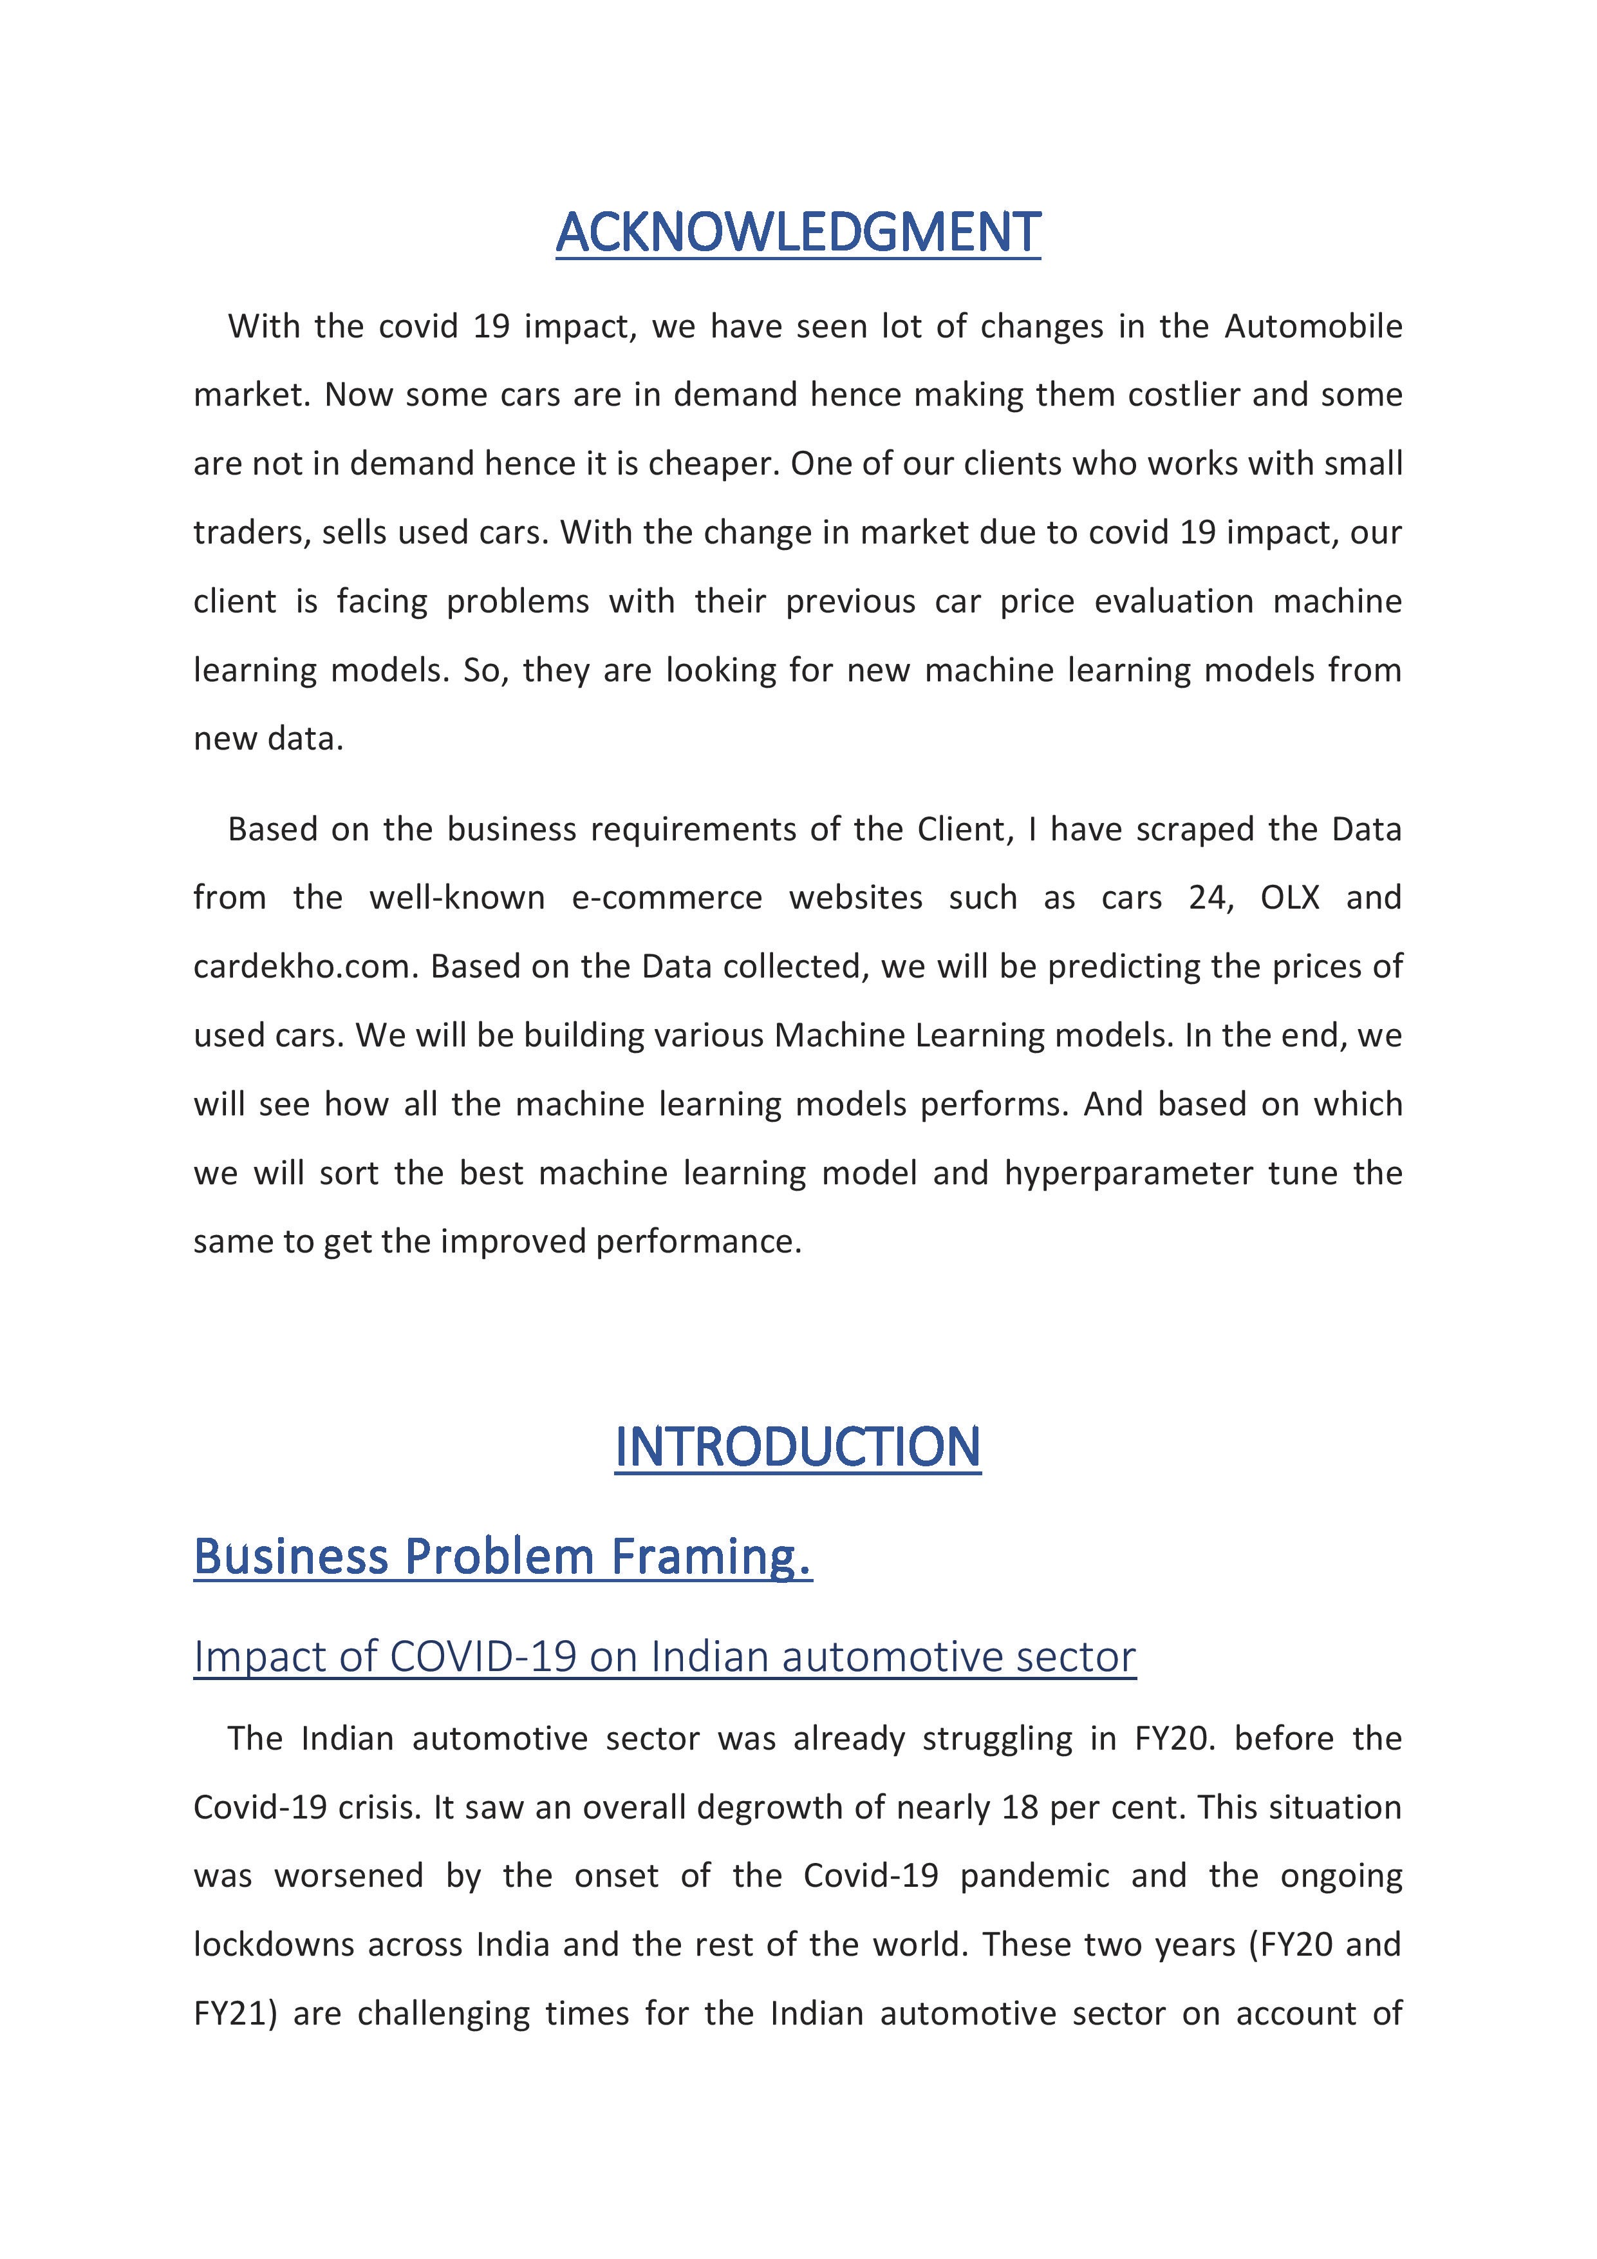

Slide 3


Slide 4
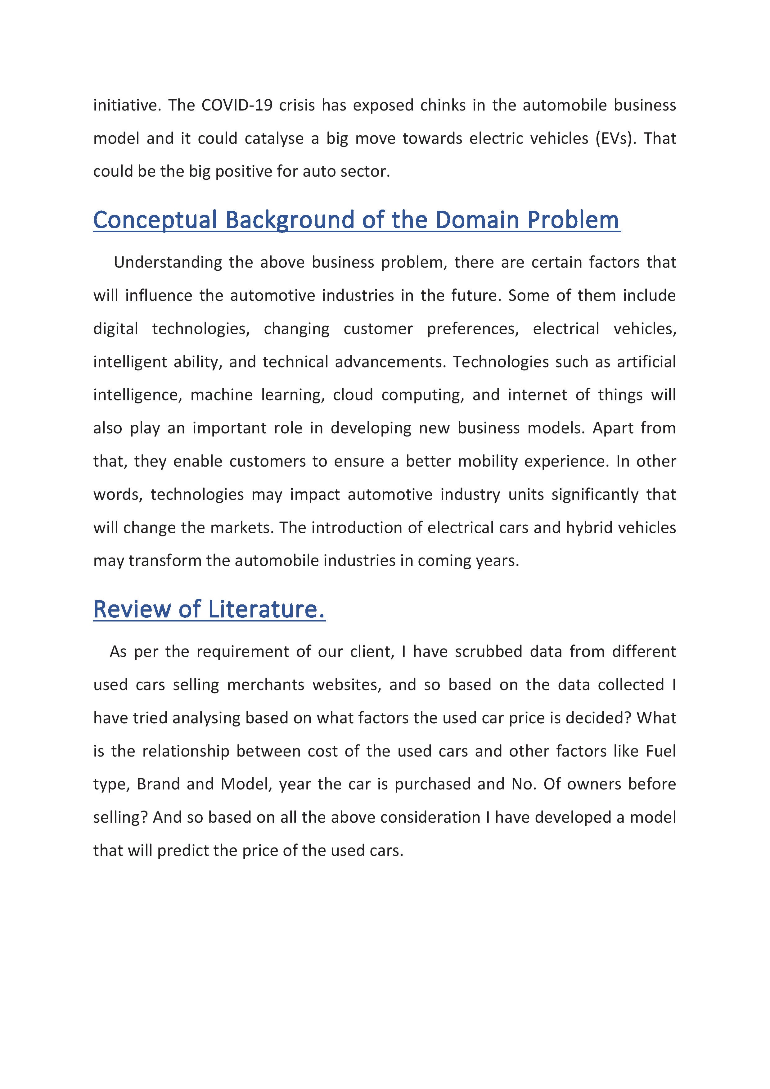

Slide 5
Exploratory Data Analysis
1. Checking the Missing Values
2.categorical data visualisation
3.numerical data and label relationship
4.checking outlier
5.checking skewness and distribution of numerical data

Slide 6
MISSING VALUES
we will find missing values
We have seen there are 287 null values in variant so we have to fill it.after knowing
Manual is mode so we will fill missing value with manual
LOCATION 0 MNF_YEAR 0 BRAND 0 MODEL 0 VARIANT 287 DRIVEN_KM 0 FUELTYPE 0 NOOF_OWNERS 0 PRICE 0
Manual 6461 Automatic 1110

Slide 7
we have to convert data type of columns which has wrong data type
<class 'pandas.core.frame.DataFrame'> RangeIndex: 7858 entries, 0 to 7857 Data columns (total 9 columns): # Column Non-Null Count Dtype --- ------ -------------- ----- 0 LOCATION 7858 non-null object 1 MNF_YEAR 7858 non-null int64 2 BRAND 7858 non-null object 3 MODEL 7858 non-null object 4 VARIANT 7858 non-null object 5 DRIVEN_KM 7858 non-null object 6 FUELTYPE 7858 non-null object 7 NOOF_OWNERS 7858 non-null object 8 PRICE 7858 non-null object

Slide 8
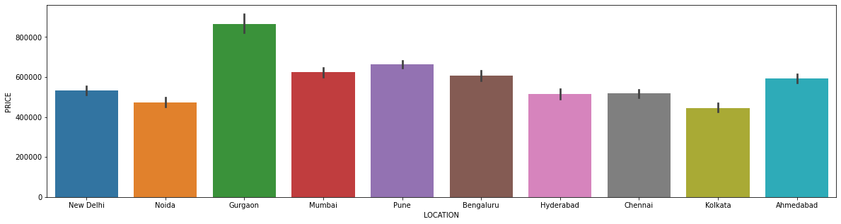
Data visualisation

Slide 9
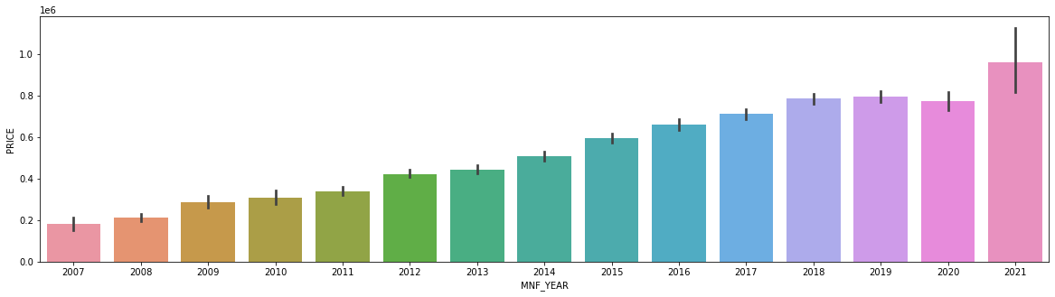
Price vs MNF YEAR

Slide 10
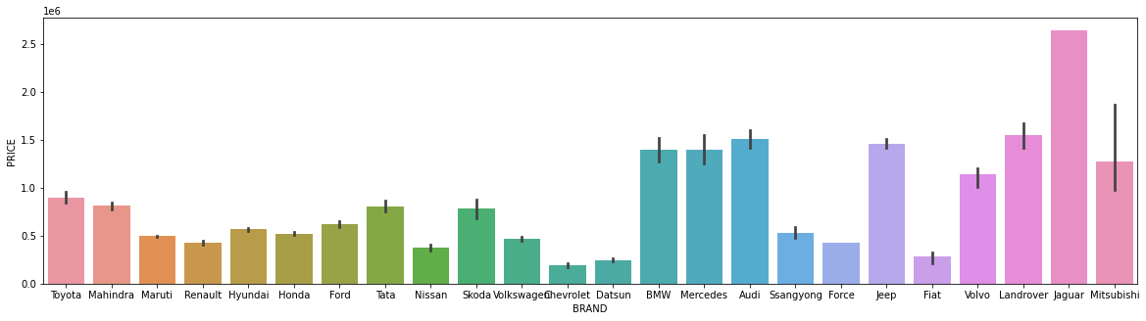
PRICE VS BRAND

Slide 11
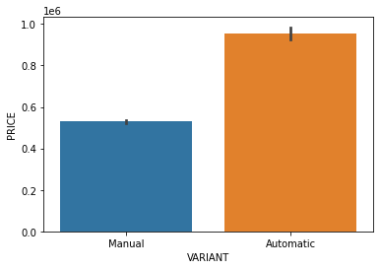
PRIVE VS VARIANT

Slide 12
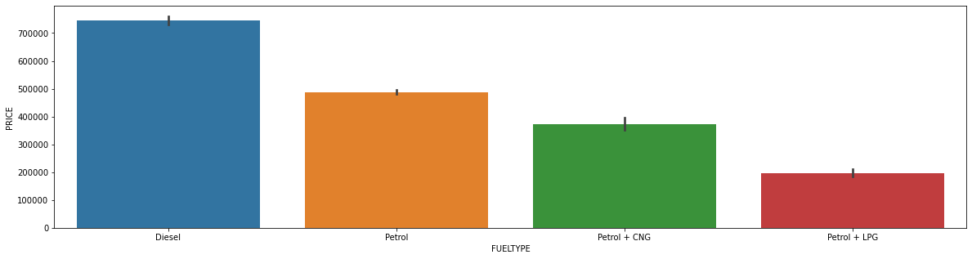
PRICE VS FUELTYPE

Slide 13
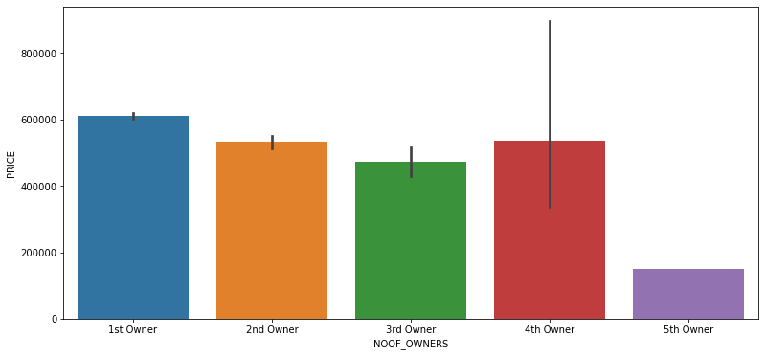
PRICE VS NOOF_OWNERS

Slide 14
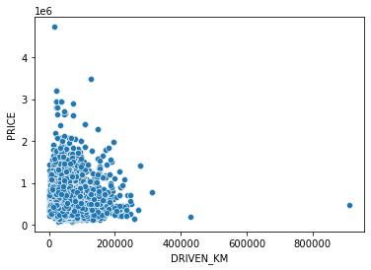
PRIC VS DRIVEN_KM

Slide 15
We will do encoding to convert categorical data into numeric form
for i in df.columns:
if df[i].dtypes=="object":
df[i]=enc.fit_transform(df[i].values.reshape(-1,1))

Slide 16
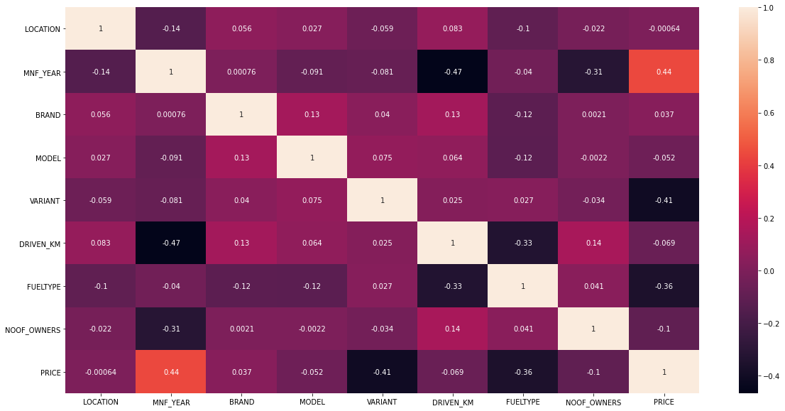
CORRELATION
We will see which features are correlated more

Slide 17
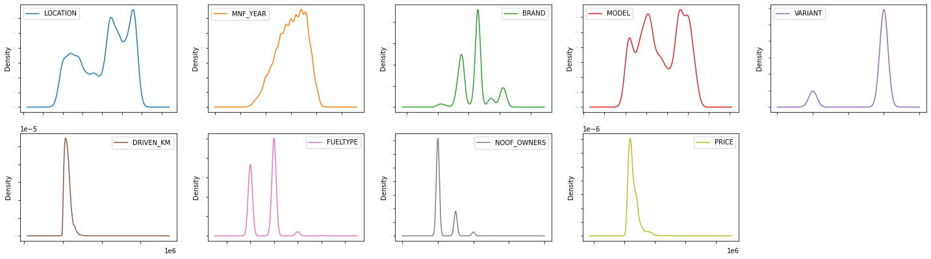
We will look thorugh the distribution of column

Slide 18
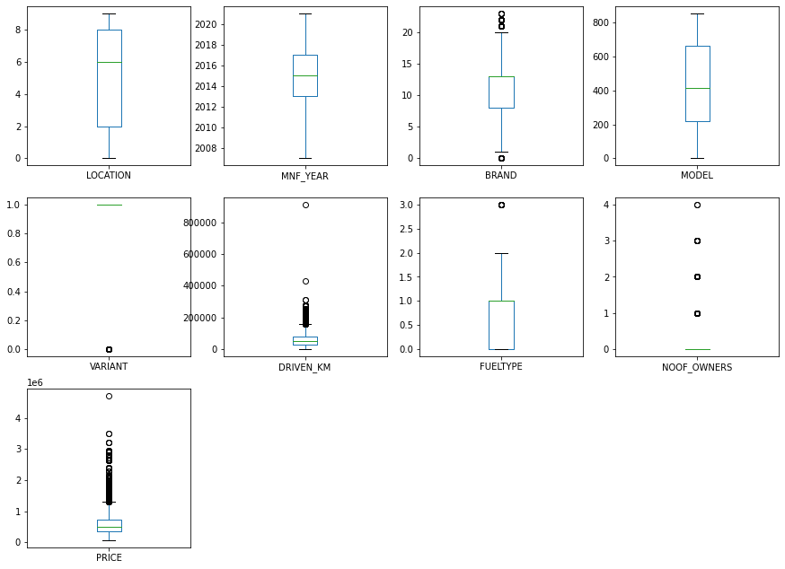
Checking outlier

Slide 19
We have seen there are outlier so we have to remove it
After removing our data loss was 6% so we can move further
Now we will scale data using standard scalar

Slide 20
Model bulding
We will use five model
1) linear regression
2)randomforest regressor
3)knneighbour regressor
4)gradientbossting regressor
5) AdaBoostRegressor

Slide 21
conclusion
After finding accuracy we come conclusion that gradient boosting regressor has high accuracy
So we will hypertune that that model
.and our final accuracy is after hypertuning is 87%

